Slide 1

Vendor SailPoint IIQ
IDAM Holiday Readiness 2023​

Slide 2
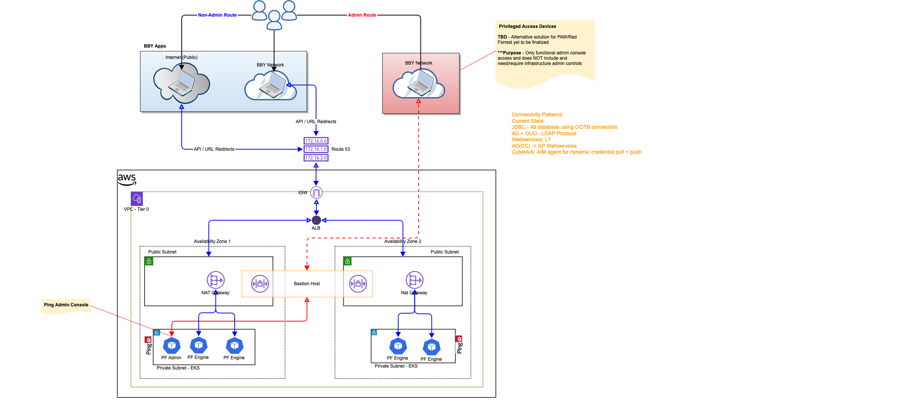
Access Patterns – SailPoint Vendor

Slide 3
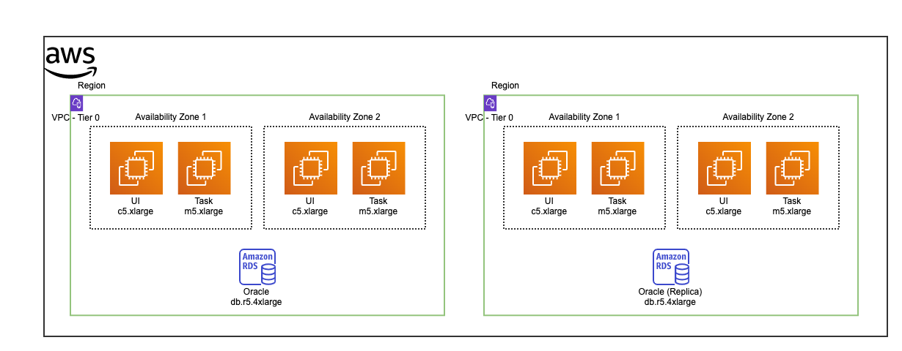
Physical Architecture - SailPoint: Vendor

Slide 4
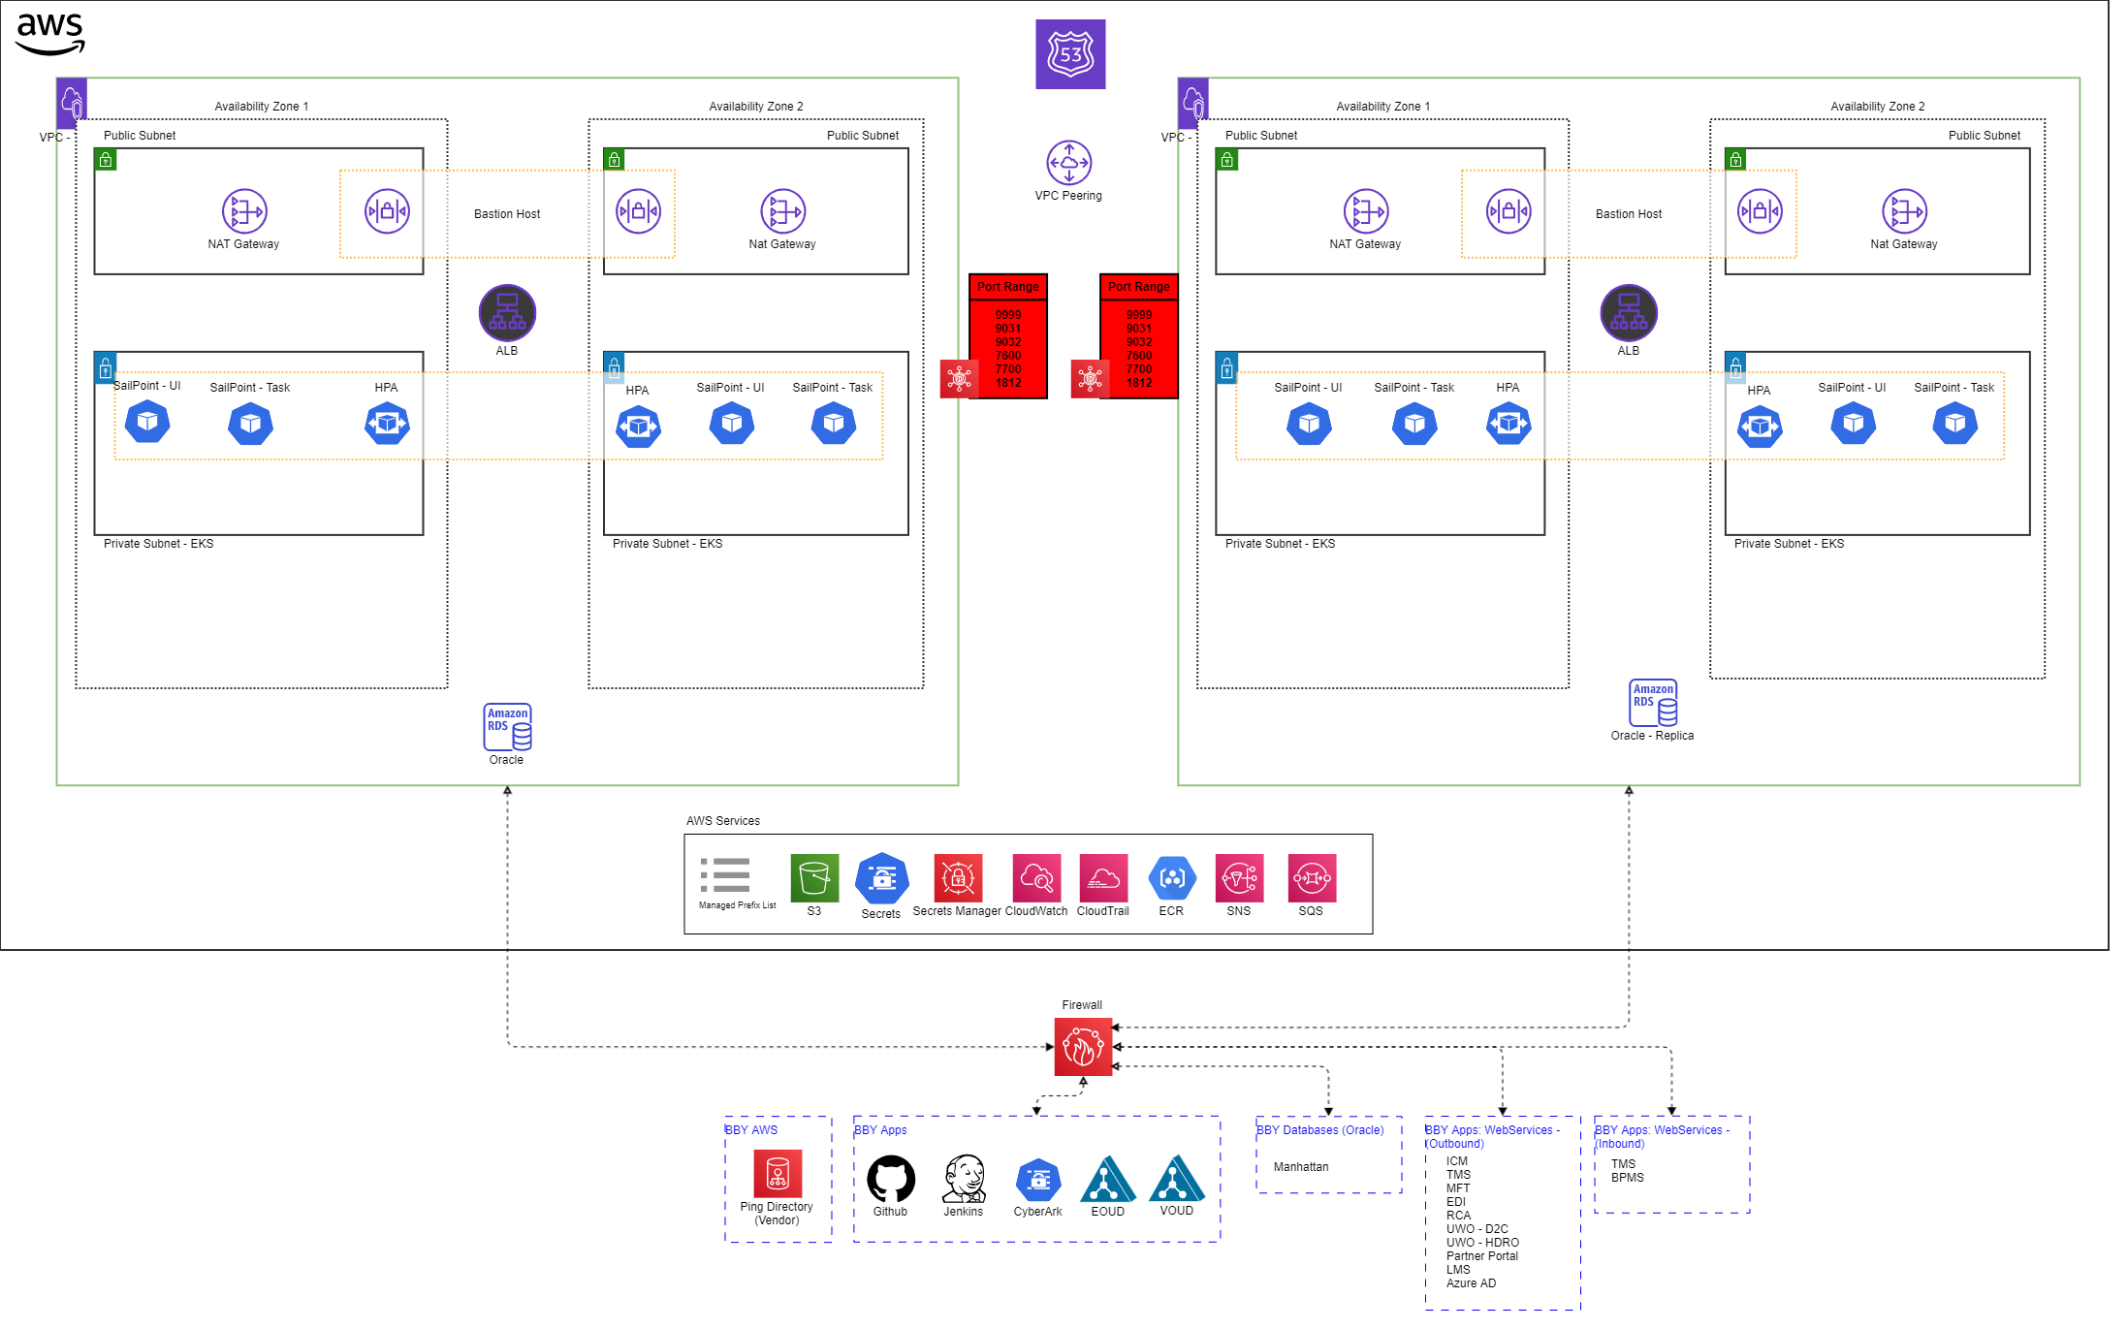
Logical Architecture - SailPoint: Vendor

Slide 5
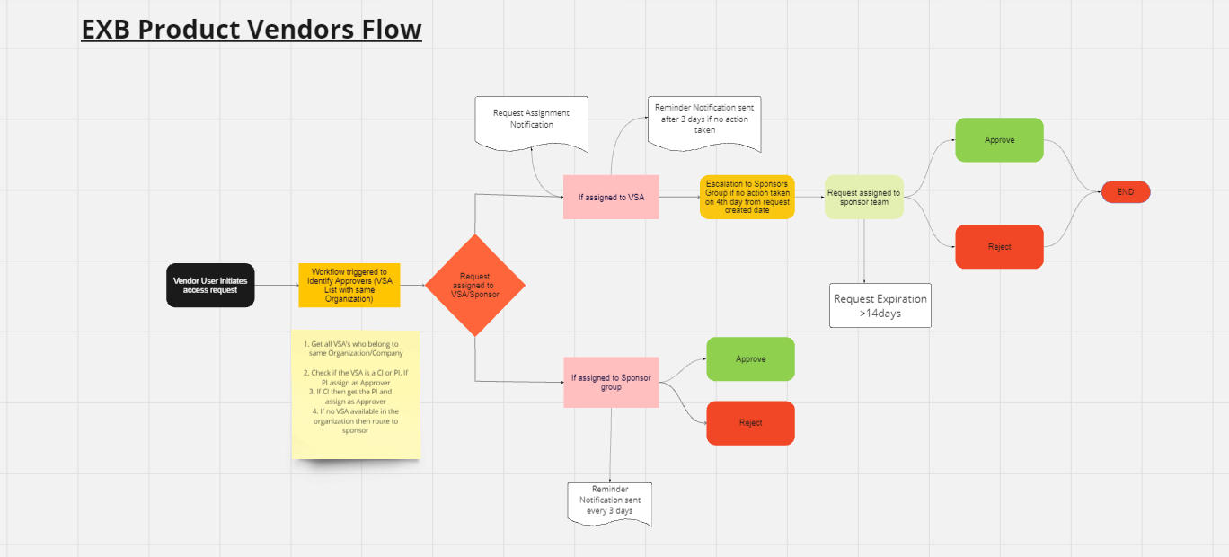
EXB Product Vendor Request Flow

Slide 6
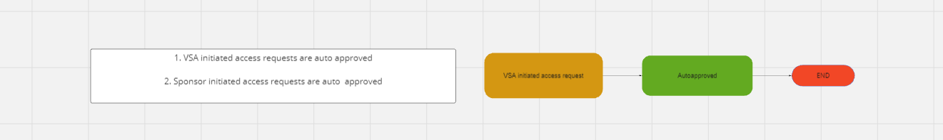
EXB Product Vendor approval Flow

Slide 7
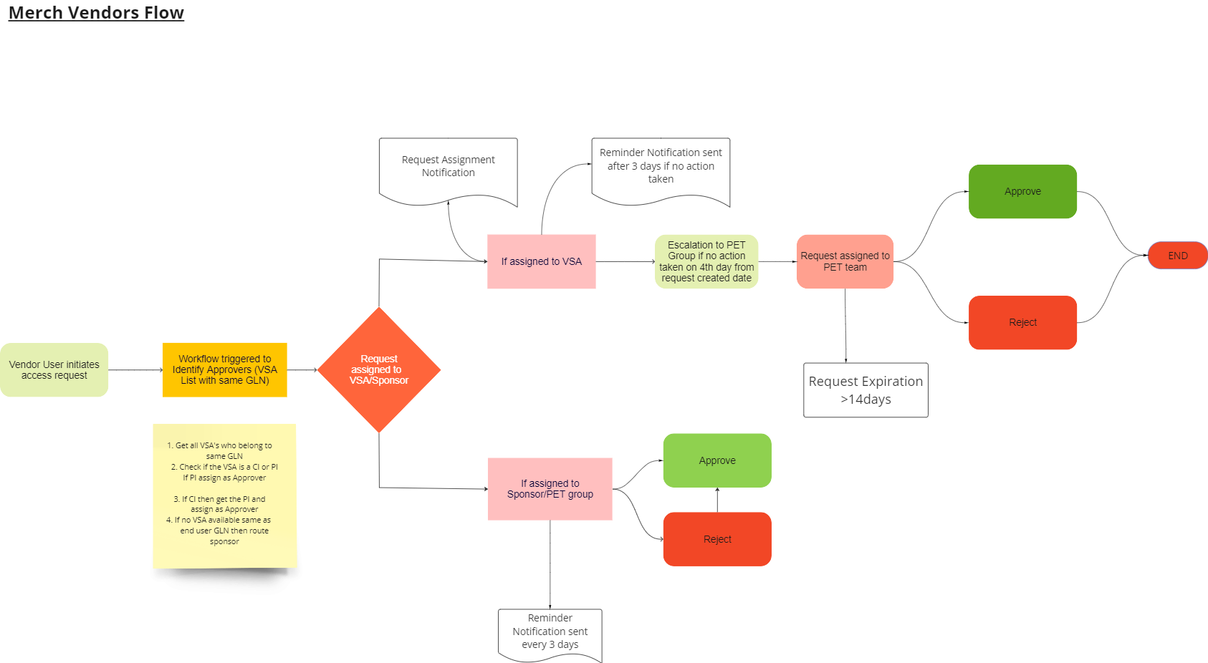
Merch Vendor's request Flow

Slide 8
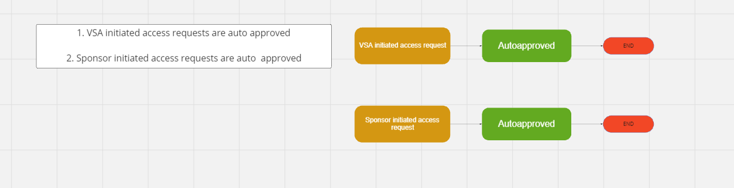
Merch Vendor’s Approval Flow

Slide 9
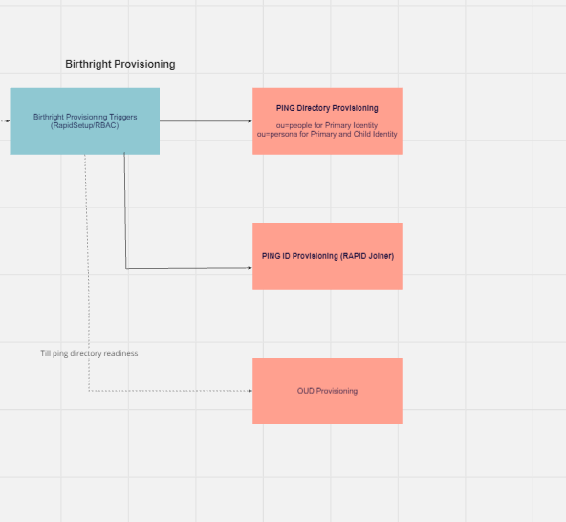
Birthright Provisioning

Slide 10
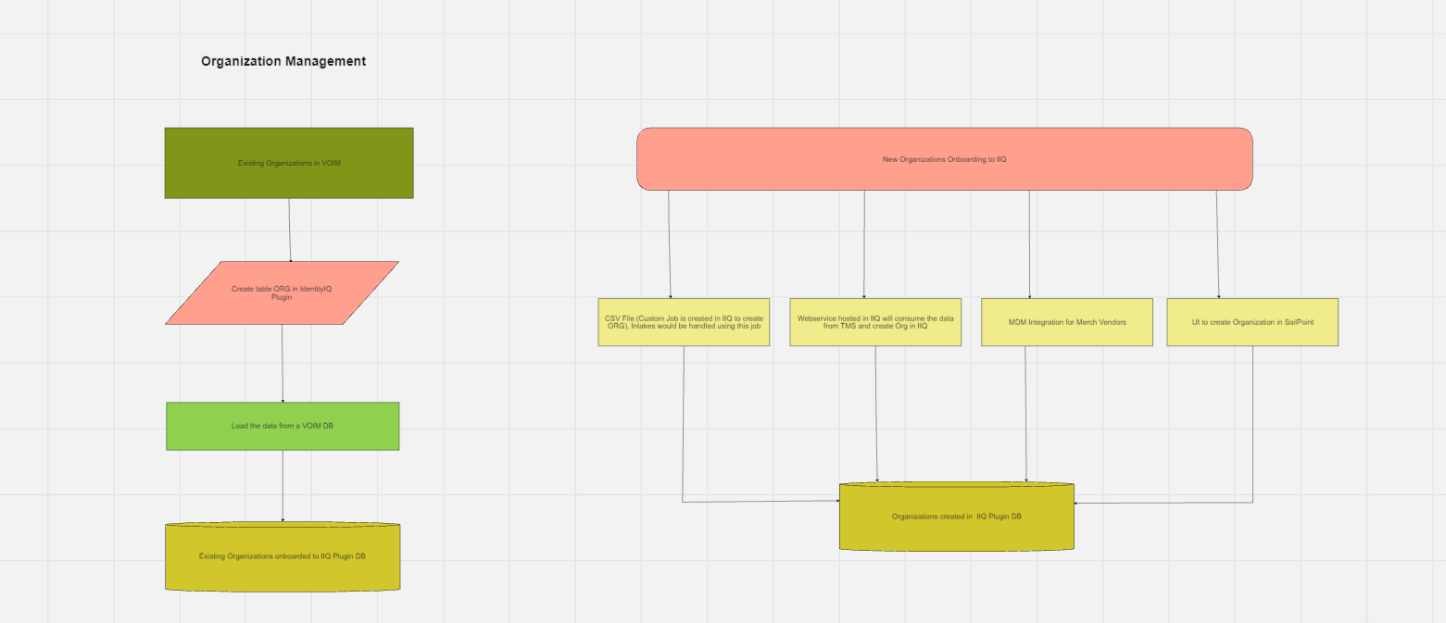
Organization Management

